Slide 1
Data warehouse implementation
Issues

Slide 2
Things to “avoid” building a DW
Setting expectations that you cannot meet and frustrating executives at the moment of truth
Loading the warehouse with information just because it is available
Choosing a data warehouse manager who is technology oriented rather than user oriented
Focusing on traditional internal record-oriented data and ignoring the value of external data and of text, images, and, perhaps, sound and video
Believing that data warehousing database design is the same as transactional database design
Focusing on ad hoc data mining and periodic reporting instead of alerts

Slide 3
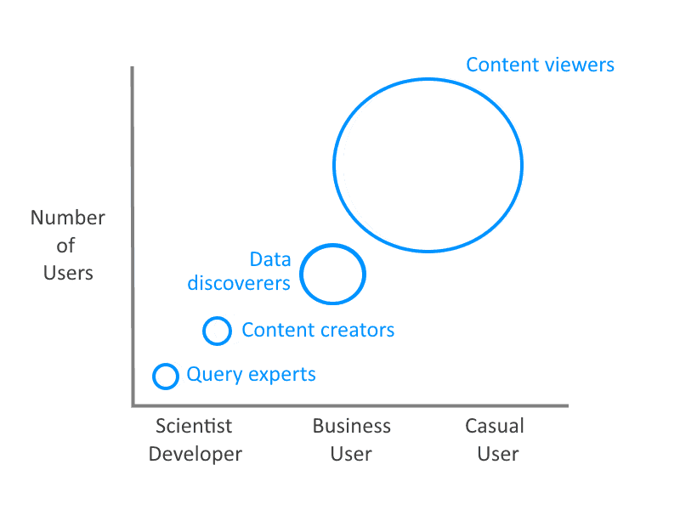
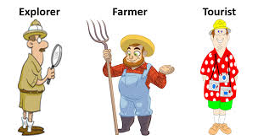
Use the users...
But who are they?

Slide 4
Scalability
The main issues pertaining to scalability:
The amount of data in the warehouse
How quickly the warehouse is expected to grow
The number of concurrent users
The complexity of user queries
Good scalability means that queries and other data-access functions will grow linearly with the size of the warehouse

Slide 5
Administration and Security
Data warehouse administrator (DWA)
DWA should…
have the knowledge of high-performance software, hardware, and networking technologies
possess solid business knowledge and insight
be familiar with the decision-making processes so as to suitably design/maintain the data warehouse structure
possess excellent communications skills
Security and privacy is a pressing issue in DW
Safeguarding the most valuable assets
Government regulations (HIPAA, etc.)
Must be explicitly planned and executed

Slide 6
Data Warehouse Testing - An overview
The data warehouse testing process involves ensuring data quality by running it through various valid test cases.
There are three levels of testing, unit, integration and system testing.
Testing teams don’t always have the appropriate access and tools to extract data from sources.
Testing process is resource-intensive and time-consuming

Slide 7
Build a star schema
You are working at the the Vue cinema.
They asked you to find out what their audience demographics look like in relation to the movies they are watching.
You have decided to build a star schema…
In your groups take the next 20 minutes to build a star schema with 1 fact table and at least 3 dimensions.

